Slide 1

Node.js Part 1
Melissa Kendall, June 2017

Slide 2
Summary
What is Node.js?
Basics
Demos
Developer Portal

Slide 3
What is node.js?
Open source development platform
Published in 2011 (Linux only)
“JavaScript” on the server
Single threaded
Weakly typed
Interpreted, not compiled
Asynchronous

Slide 4
Javascript is strange
"0" == false; //true
"abc" == "a" + "b" + "c"; //true
null == undefined; //true
30 -"7"; //23
"30" + 7; // 307

Slide 5
basics
console.log(“Hello!”); //write to console
function createFunction(var1,var3) { } //function
createFunction(9,[]); //non-static types
var newObj = { ‘nested’: { ‘var’: ‘a’ } }; //obj
var arr; arr = 2; arr = [ ‘2’ ]; //legal
0 == false //true
0 === false; //false, strict comparison

Slide 6
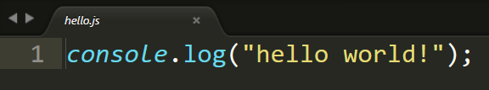

Hello world

Slide 7

Node Package Manager (NPM)
Cross-platform
Client and server
Quick to get up and running
Extremely flexible
Stores values in package.json

Slide 8

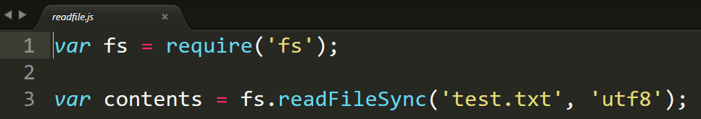
Read in file
Installs all packages in package.json
To install and save a new package, use npm install (name)--save
Must specify file format

Slide 9
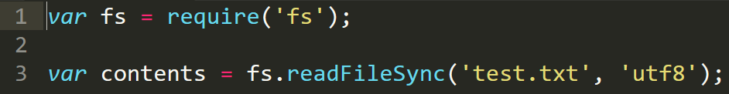
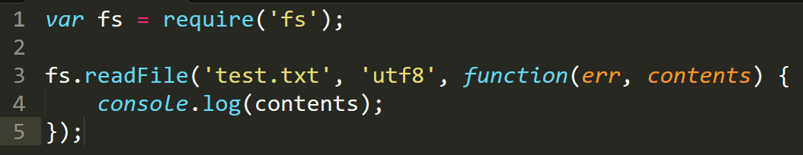
Async vs sync
Sync – “normal” behavior, will wait for readFileSync
Async – non-blocking behavior, will not wait for readFile
Callback function, more on this later

Slide 10

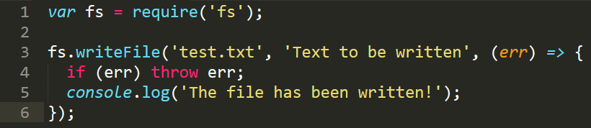


Write to file

Slide 11
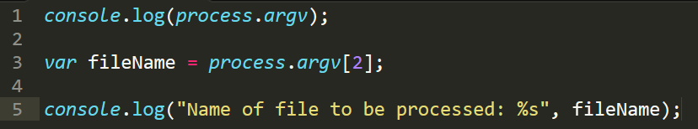
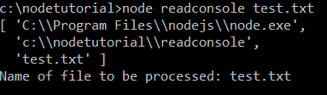
Read from console
util.format() – replace in order
%s – string
%d – number
%j – json
%% - % sign

Slide 12
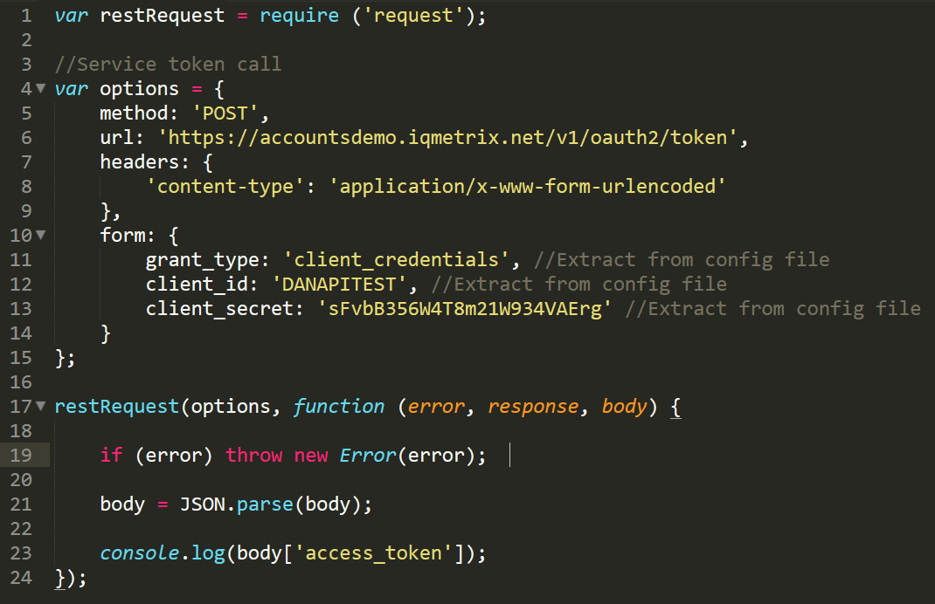
make api call
NEVER DO THIS
Turn into JSON. Node likes JSON

Slide 13
Generate.js
Read in RAML
Generate Linkrefs
generator.js
Generate Markdown
Read from /raml
Gather metadata
Place into array
Create variables for all resource links
Pluralize
Used in other pages as {{Company}}
Replace constants
Do custom styling
Lots of small custom code snippets
Write to /pages

Slide 14
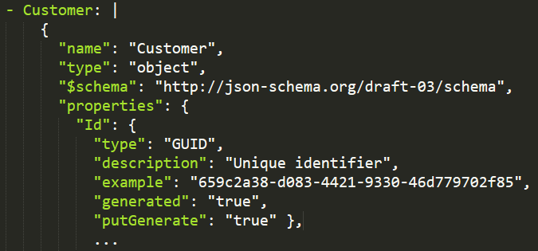
Custom schema properties
Non-standard properties

Slide 15
Postman2raml.js
Read in Postman
Make API Calls
Create Schemas
Generate
raml
Read postman.json
Read env.json
Read config.json
Must be in /
Postman v2 only
Inflexible – project?
Perform each request
Data Connect – jsonDataTable
Make RAML schema
Determine type
Set example
postman2raml.nunjucks

Slide 16
Create.js
Extract values
Get Token
Make API Calls, in Order
Format Response
Must be provided
Comma separated list
Get service token
Hard coded credentials
Sale Order
Order Management
Product Details
Extract values to make calls
Create new object
Print ProductData.json

Slide 17
Developer portal architecture
API Specification – RAML
Server scripts – Node.js
HTML Templating – Nunjucks and Liquid
Guides – Markdown
Web server – GitHub Pages

Slide 18
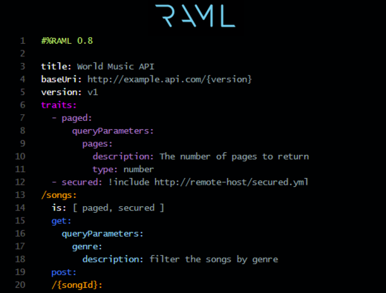

RAML

Slide 19
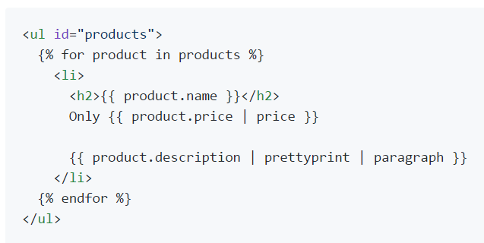
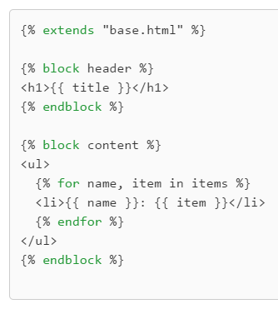
Nunjucks / Liquid
Nunjucks (Mozilla)
Liquid (Shopify)

Slide 20
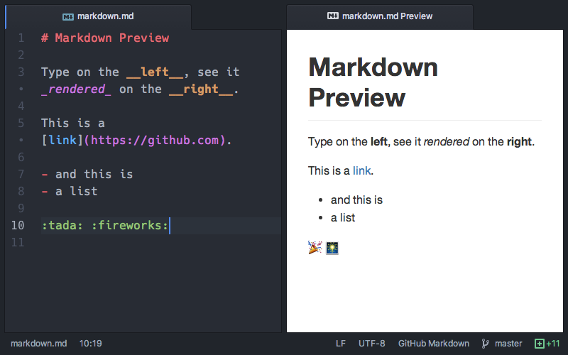
markdown

Slide 21
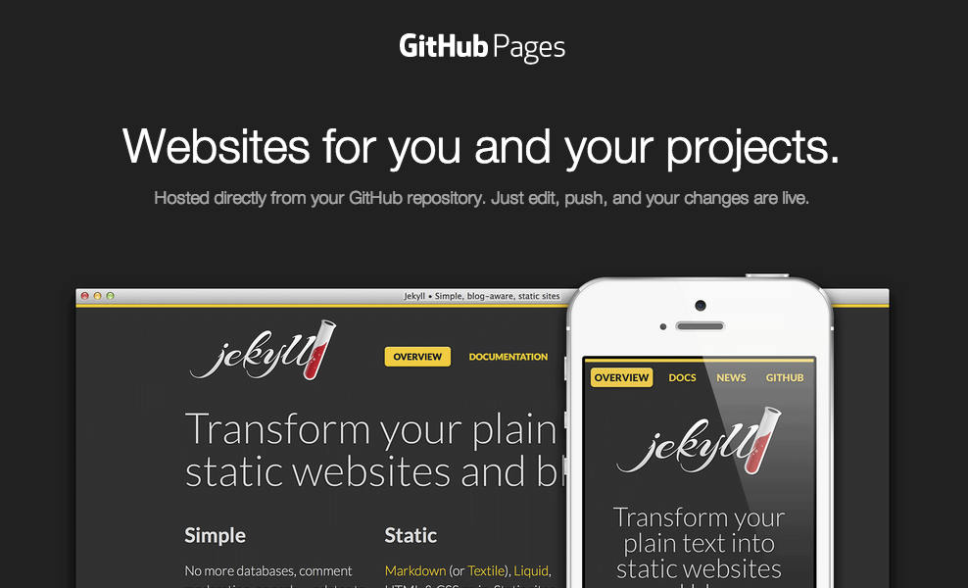
Github pages

Slide 22
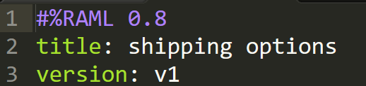
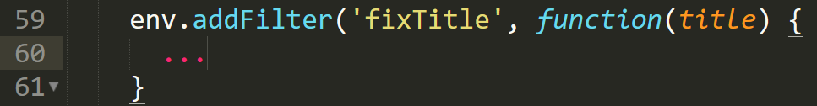
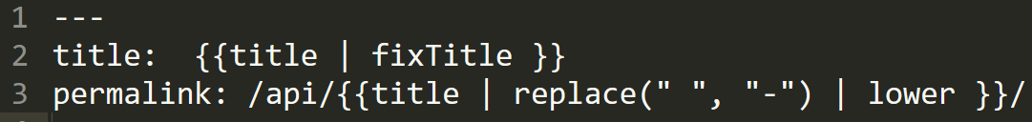
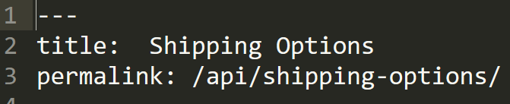
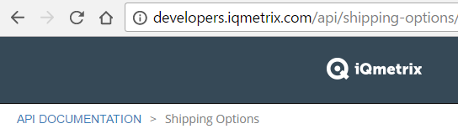
RAML
Nunjucks
Custom function in generator.js
Markdown
GitHub Pages

Slide 23
End of part 1

Slide 24
Resources
Presentation and examples
https://github.com/melissakendall/node-tutorial
Presentation based on
https://code-maven.com/getting-started-with-nodejs

Slide 25
Node.js Part 2
Melissa Kendall, June 2017

Slide 26
Summary
Callbacks
Managing Promises
Debugging tips & tricks

Slide 27
callbacks
Name of a convention for using JavaScript functions
Common during I/O – i.e. reading files
Normal function
Callback function

Slide 28
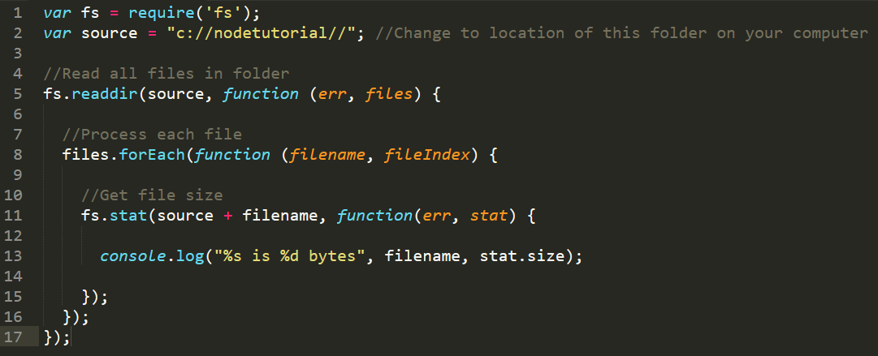
Callback hell

Slide 29
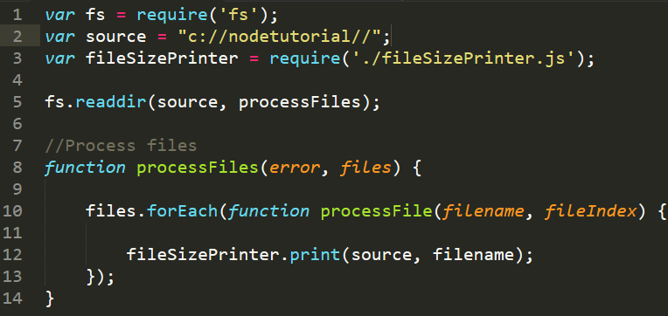
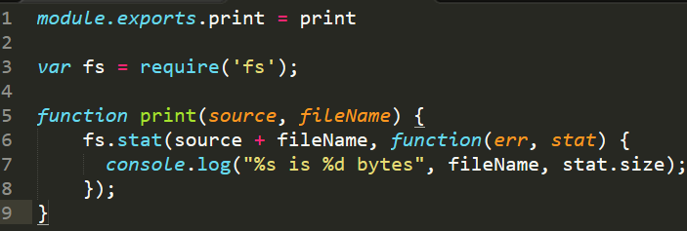
Better callbacks – Modularize
Anyone can create modules (libraries)
Refactor functions to “module” objects
fileSizePrinter.js

Slide 30
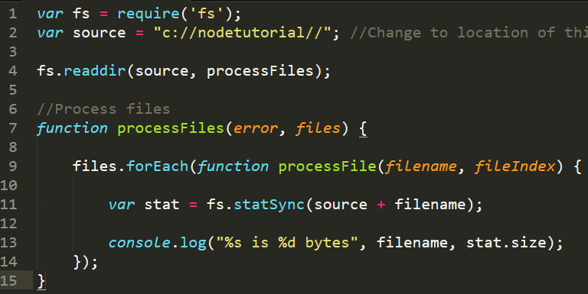
Better callbacks - force sync
Many packages provide a sync option
If you only have one async function, why not?

Slide 31
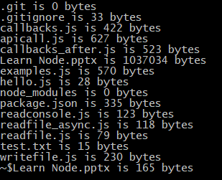
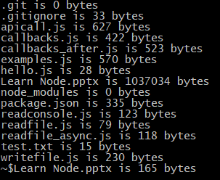
Callbacks – race conditions
Run callbacks.js and callbacks_sync.js… The results are different!
Async means order not guaranteed
Result - race conditions!
node callbacks.js
node callbacks_sync.js

Slide 32
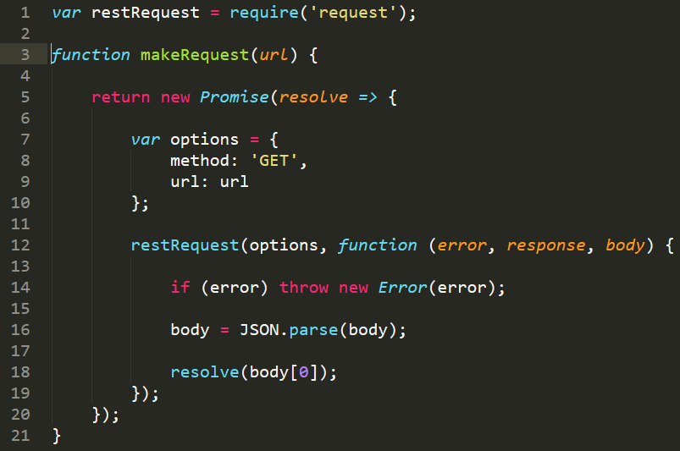
promises
Result of an async method until completion
console.log(fs.stat(source + fileName)); //Promise <pending>

Slide 33
promise management
Force async calls to resolve in specific order
I.e. Make API calls in order
Many promise libraries, we will use q

Slide 34
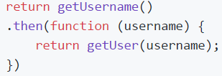
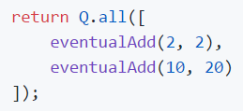

Q Features
Perform promises in order
Combine promises
Wait for all promises to resolve

Slide 35
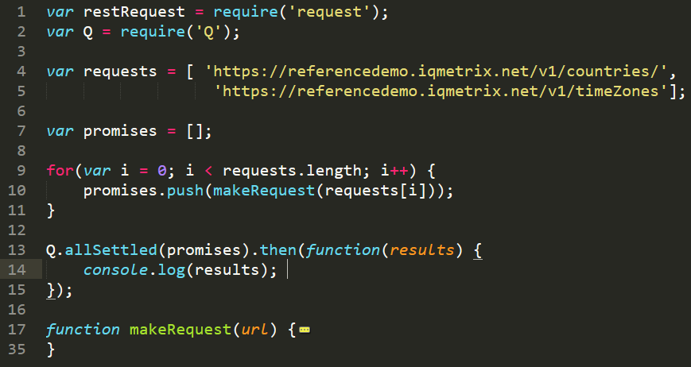
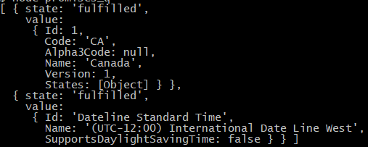

Slide 36
debugging
No compiler!?
Race conditions
console.log() is your friend

Slide 37
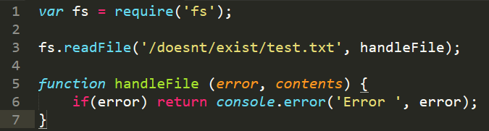

Debugging – Error Handling
Handle every single error
Reserve first argument for error
Reduces silent failures

Slide 38
Debugging – Debuggers!
Node ships with a debugger
Pause, break, resume functions
3rd party libraries
Chrome debugging

Slide 39
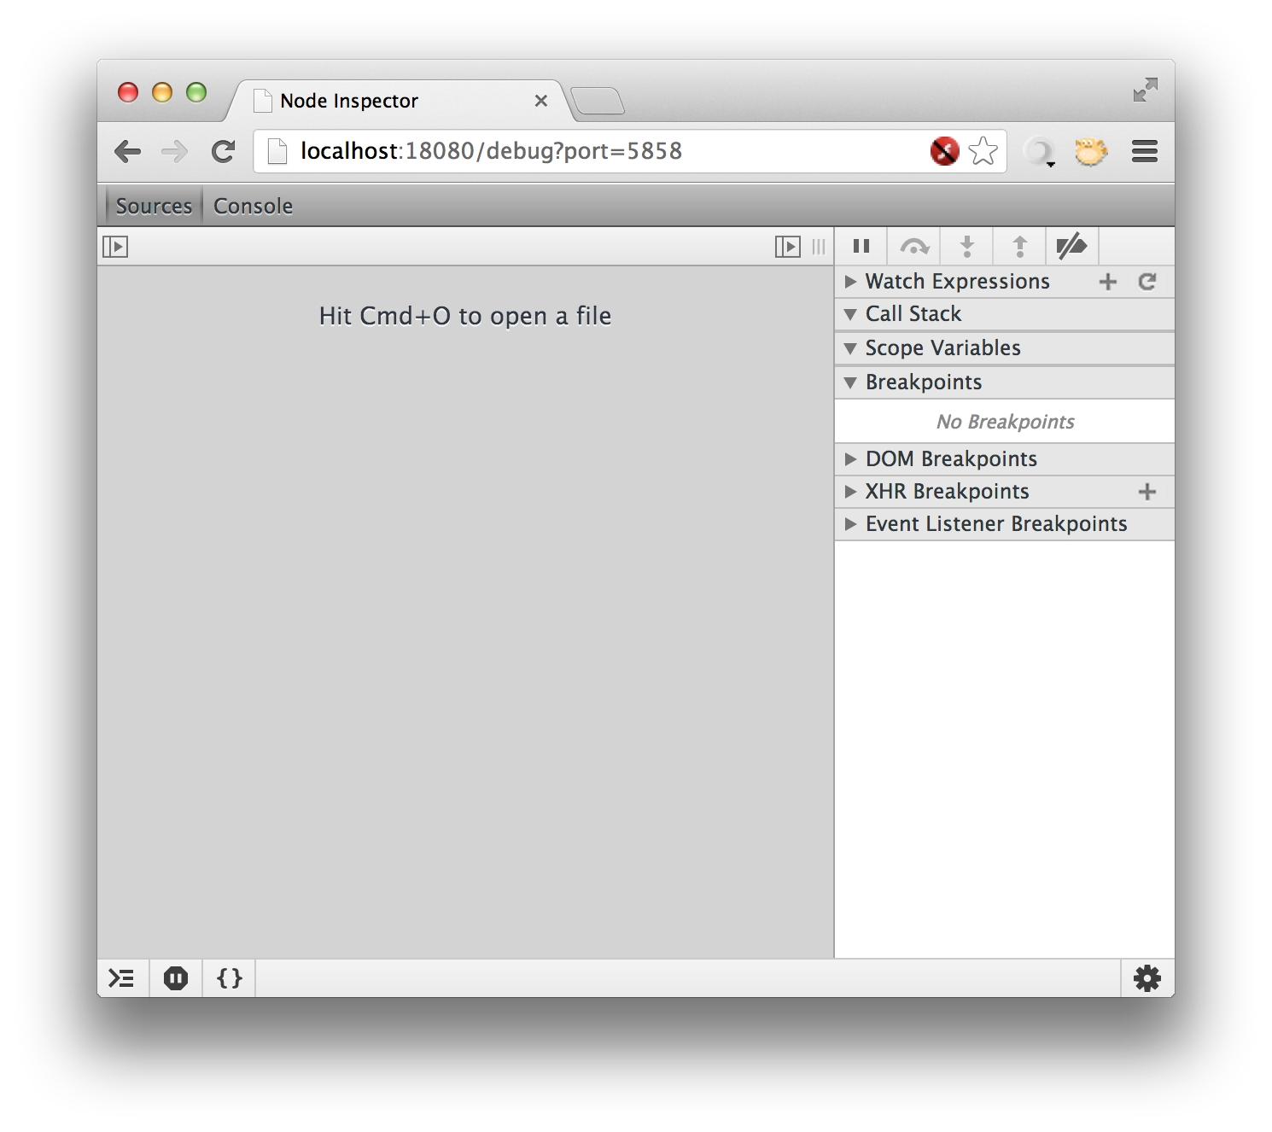
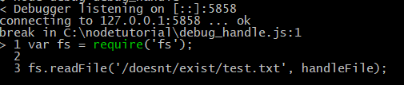
Debuggers

Slide 40
Resources
Presentation and examples
https://github.com/melissakendall/node-tutorial
Presentation based on
http://callbackhell.com/
Debugging resources
http://www.nearform.com/nodecrunch/node-js-develop-debugging-techniques/

